Slide 1


Chapter 6
Installing Linux on a Virtual Machine
Virtualization Essentials

Slide 2
Chapter 6 Objectives
Understand the steps to load Ubuntu Linux into a virtual machine
Understand the steps needed to install the Guest Additions into a Linux virtual machine
Examine some virtual machine configuration options
Examine some optimizations for a Linux virtual machine
2

Slide 3
Why Linux?
Linux is a growing choice as a server operating system
As older proprietary systems fall out of favor, those legacy applications are being migrated to Linux
Many newer applications are being designed for open source architecture frameworks, rather than vendor-specific solutions
Lower cost is a large factor
3

Slide 4
Installing Linux into a VM
Same process as installing Linux onto a physical server
Choose boot device at power-on
DVD or ISO image file
Example walk-through is one installation path, not necessarily the definitive one
Linux involves more understanding of the installation process than Windows
4

Slide 5
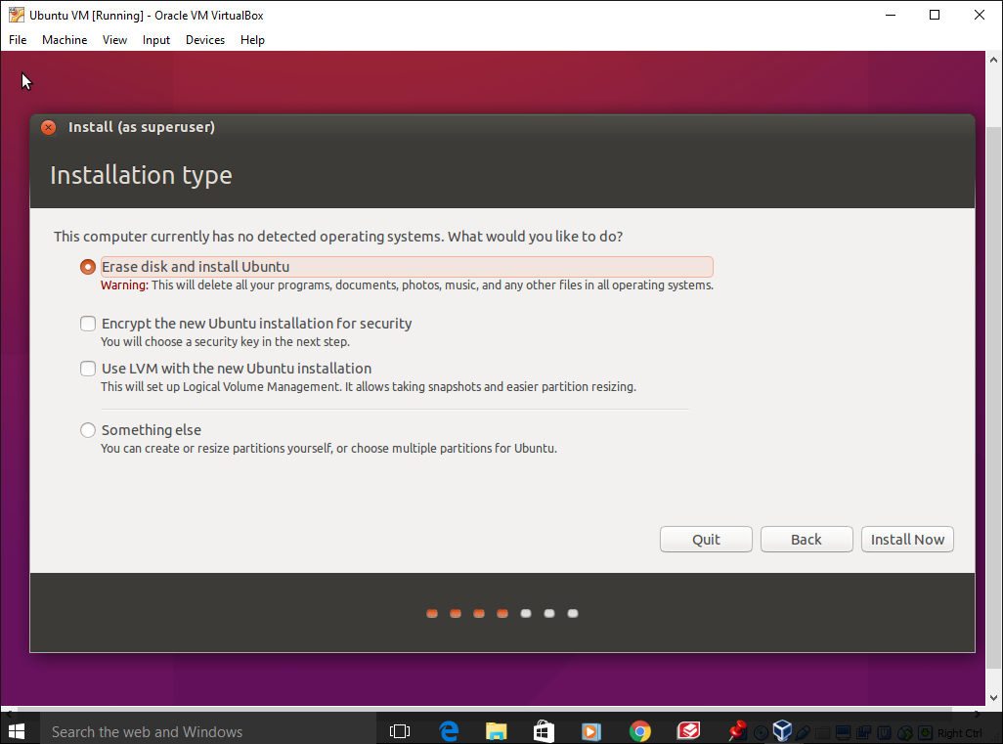
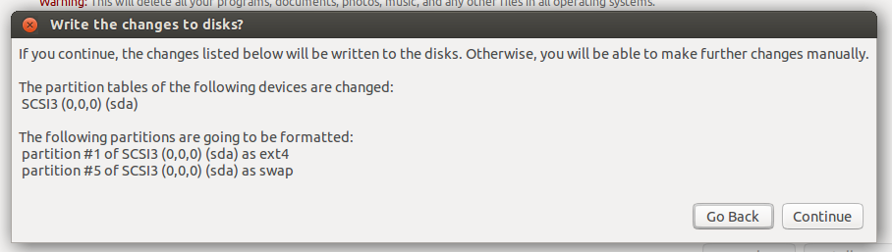
Virtual Machine Hardware
The Linux installer can only see what has been allocated to the virtual machine
The warnings about erasing and formatting the disk apply to the virtual disks, not the physical disks on the host
5

Slide 6
Installing Guest Additions
Guest Additions, like VMware Tools, are installed to enhance the user experience, improve performance, and help manage the VM
Usually need to be installed as the root user or a super user
Installation is done through a wizard
Additional information in Chapter 12
6

Slide 7
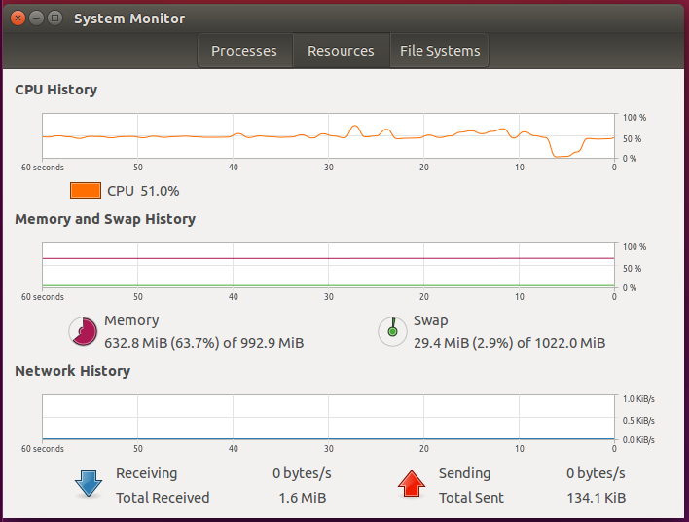
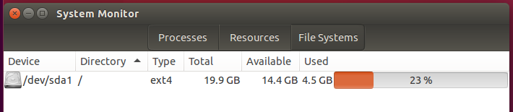
Examine the Virtual Machine
The Linux virtual machine can only see what it has been allocated
1 GB memory
20 GB of disk (14.4 GB remaining)
7

Slide 8
Proper Linux Timing
All virtual machines require proper time synchronization; however, Linux had been particularly susceptible to timing issues
Virtual machines have no CPU so they depend on their host’s clock
Network Time Protocol (NTP) allows multiple hosts to stay in time sync (www.ntp.org)
Less of an issue today than in the past as kernel routines have improved
8

Slide 9
Optimizing a Linux VM
Certain processes, or daemons, that run on Linux are not necessary in a virtual environment
Disabling these processes can save CPU and memory resources
Linux applications and functionality suites are distributed as packages; installing only the packages necessary will save disk space and often reduce the number of daemons
Gathering metrics is key to maintaining good performance
9

Slide 10
Chapter 6 Summary
Installing Ubuntu Linux into a virtual machine is identical to the physical server installation process
Guest Additions are installed to enhance the user experience, improve performance, and help manage the virtual machine
Inspection of a system configuration can determine whether it is a physical or virtual server
Certain Linux processes and components can and should be eliminated from a virtual machine deployment as they waste resources or are not applicable to a virtual deployment
10

